Slide 1
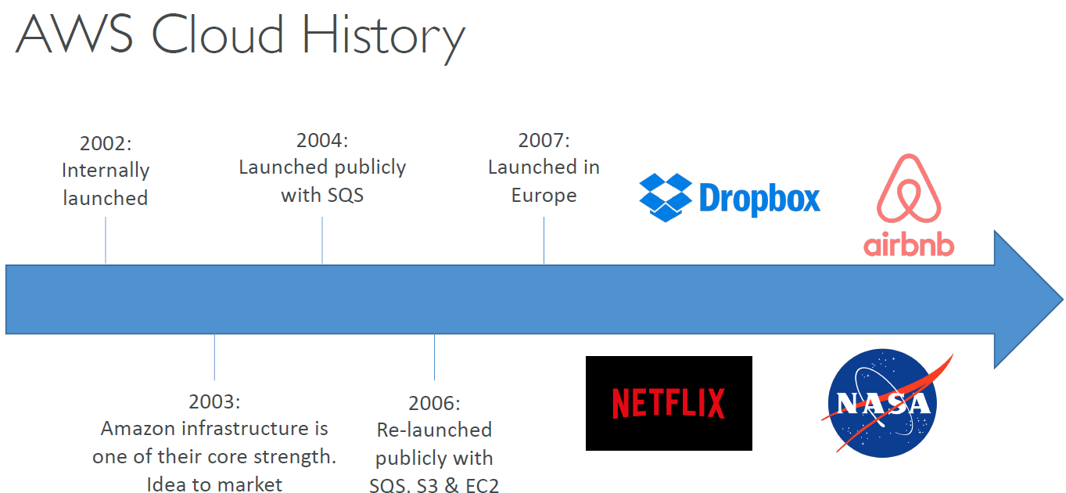

Slide 2
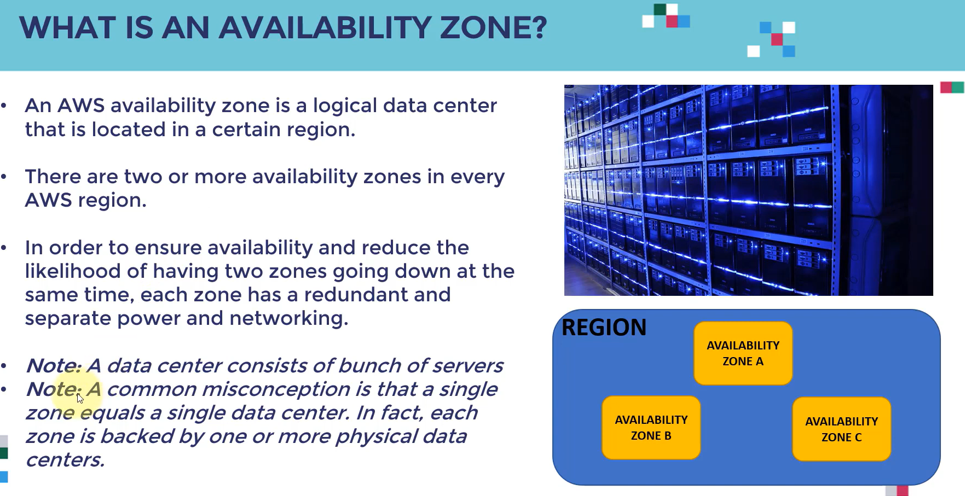
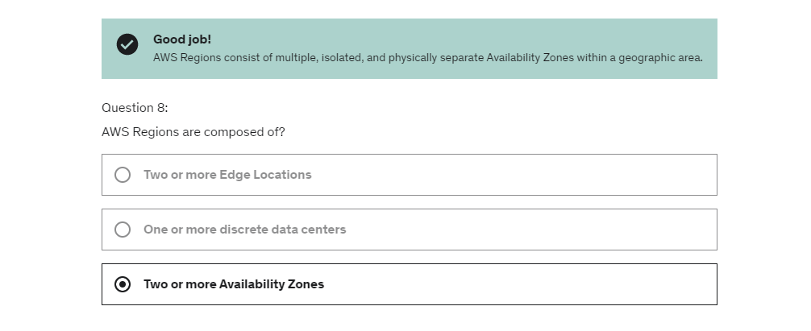

Slide 3
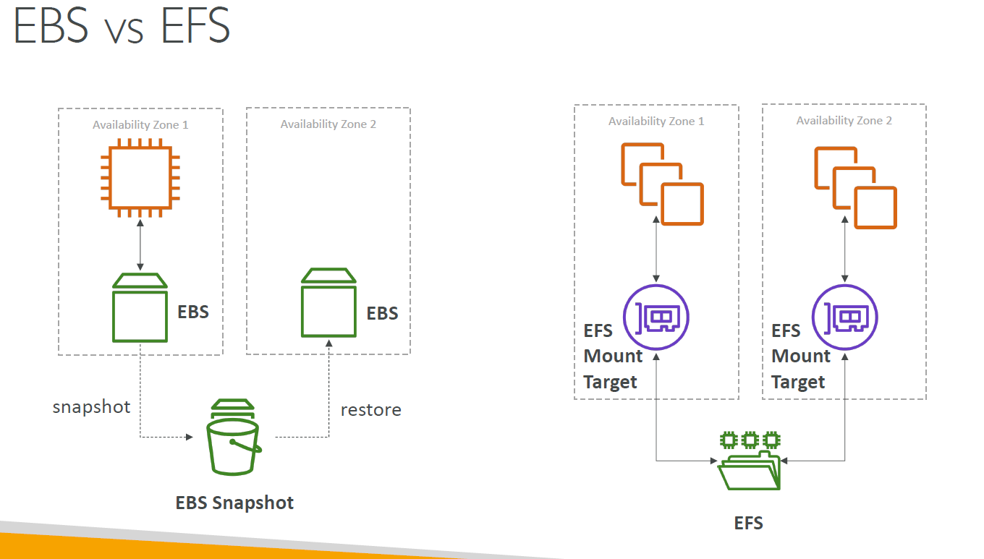
https://www-awsmonty.signin.aws.amazon.com/console

Slide 4
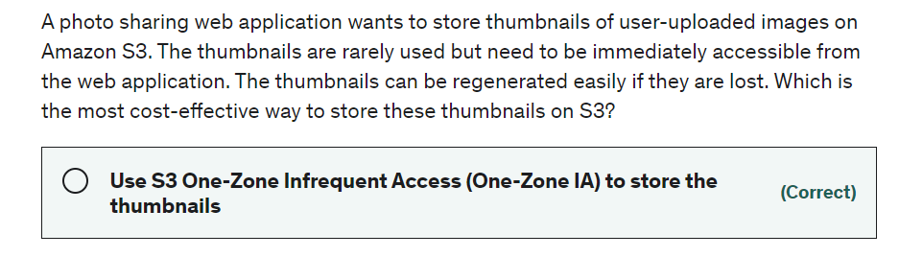
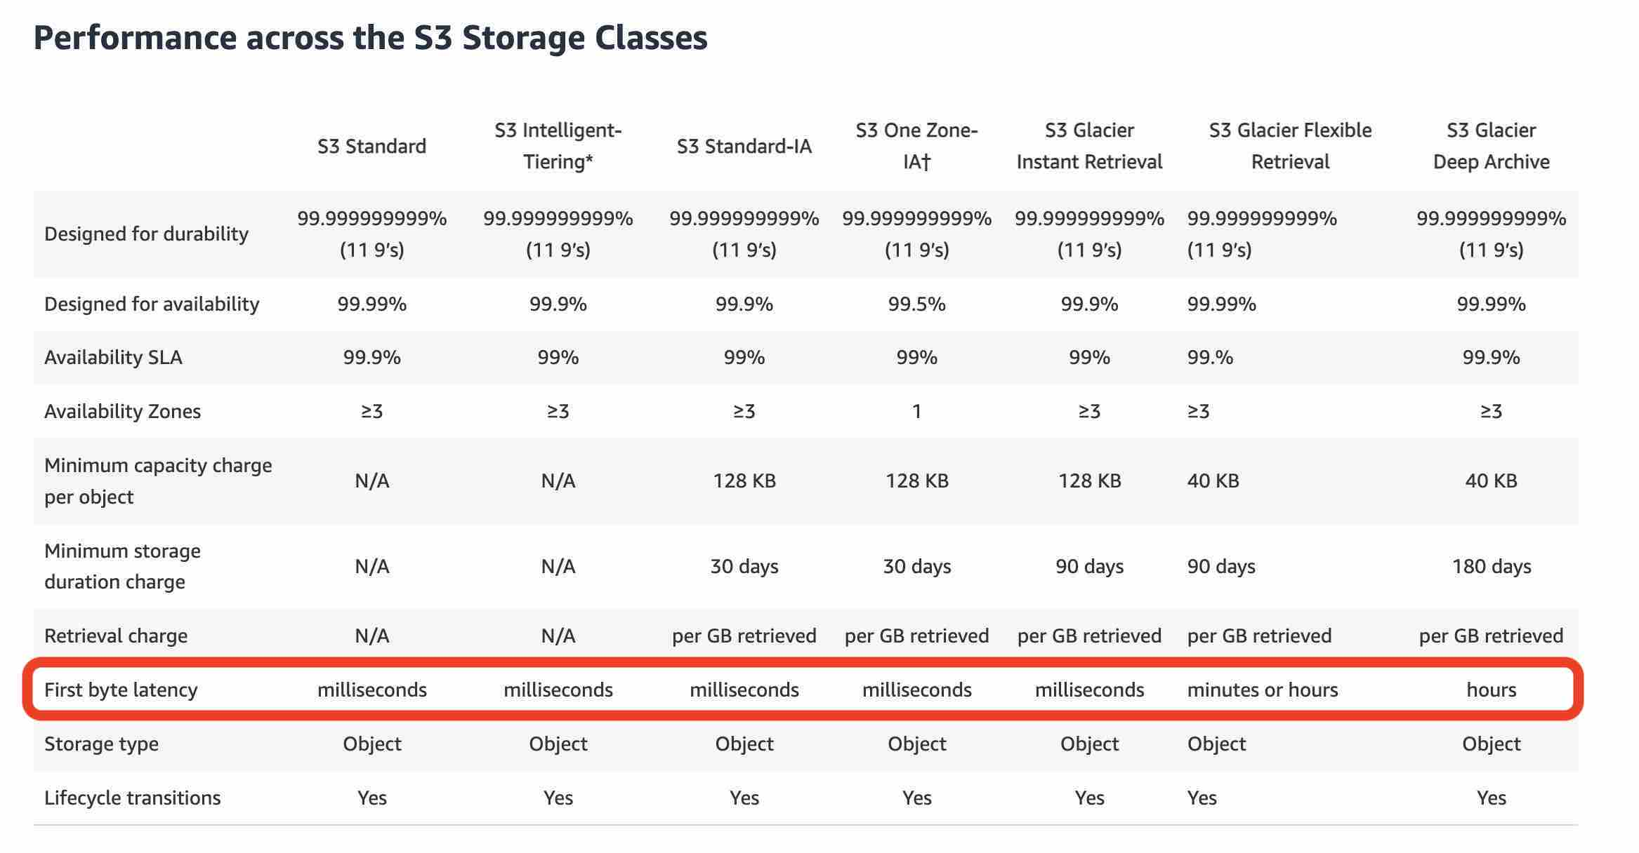
Which of the following S3 storage classes takes the most time to retrieve data (also known as first byte latency)?

Slide 5
Each AWS Region consists of two or more Availability Zones
Each Availability Zone (AZ) consists of one or more discrete data centers
AWS has the concept of a Region, which is a physical location around the world where AWS clusters data centers. Each AWS Region consists of multiple (two or more), isolated, and physically separate AZ's within a geographic area. Each AZ has independent power, cooling, and physical security and is connected via redundant, ultra-low-latency networks.
An Availability Zone (AZ) is one or more discrete data centers with redundant power, networking, and connectivity in an AWS Region. All AZ’s in an AWS Region are interconnected with high-bandwidth, low-latency networking, over fully redundant, dedicated metro fiber providing high-throughput, low-latency networking between AZ’s.
With AWS Config, you can do the following: 1. Evaluate your AWS resource configurations for desired settings. 2. Get a snapshot of the current configurations of the supported resources that are associated with your AWS account. 3. Retrieve configurations of one or more resources that exist in your account. 4. Retrieve historical configurations of one or more resources. 5. Receive a notification whenever a resource is created, modified, or deleted. 6.View relationships between resources. For example, you might want to find all resources that use a particular security group.
AWS Shield, WAF, and CloudFront with Route 53 help mitigate DDoS attacks:

Slide 6
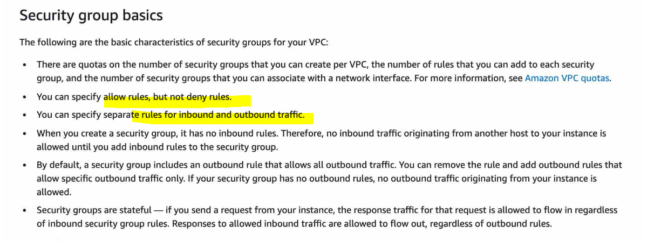
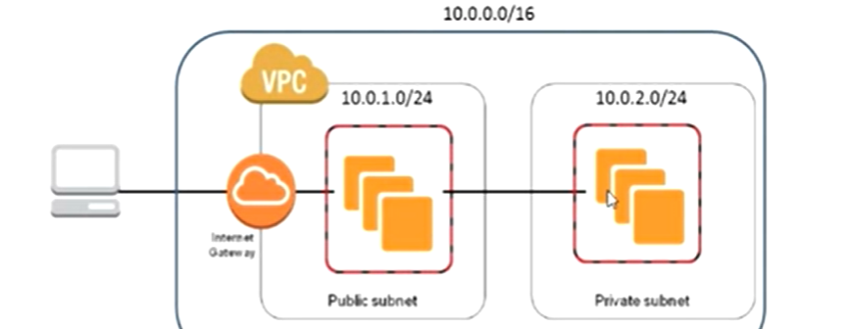
A Security Group can have allow rules only
A NAT Gateway is managed by AWS
A Network Access Control List (NACL) is an optional layer of security for your VPC that acts as a firewall for controlling traffic in and out of one or more subnets (i.e. it works at subnet level). A network ACL has separate inbound and outbound rules, and each rule can either allow or deny traffic.

Slide 7
A VPC endpoint enables you to privately connect your VPC to supported AWS services and VPC endpoint services powered by AWS PrivateLink without requiring an internet gateway, NAT device, VPN connection, or AWS Direct Connect connection. Instances in your VPC do not require public IP addresses to communicate with resources in the service. Traffic between your VPC and the other service does not leave the Amazon network.
There are two types of VPC endpoints: interface endpoints and gateway endpoints.
An interface endpoint is an elastic network interface with a private IP address from the IP address range of your subnet that serves as an entry point for traffic destined to a supported service. Interface endpoints are powered by AWS PrivateLink, a technology that enables you to privately access services by using private IP addresses.
A gateway endpoint is a gateway that you specify as a target for a route in your route table for traffic destined to a supported AWS service. The following AWS services are
Just remember that only S3 and DynamoDB support VPC Endpoint Gateway. All other services that support VPC Endpoints use a VPC Endpoint Interface.
AWS Direct Connect

Slide 8
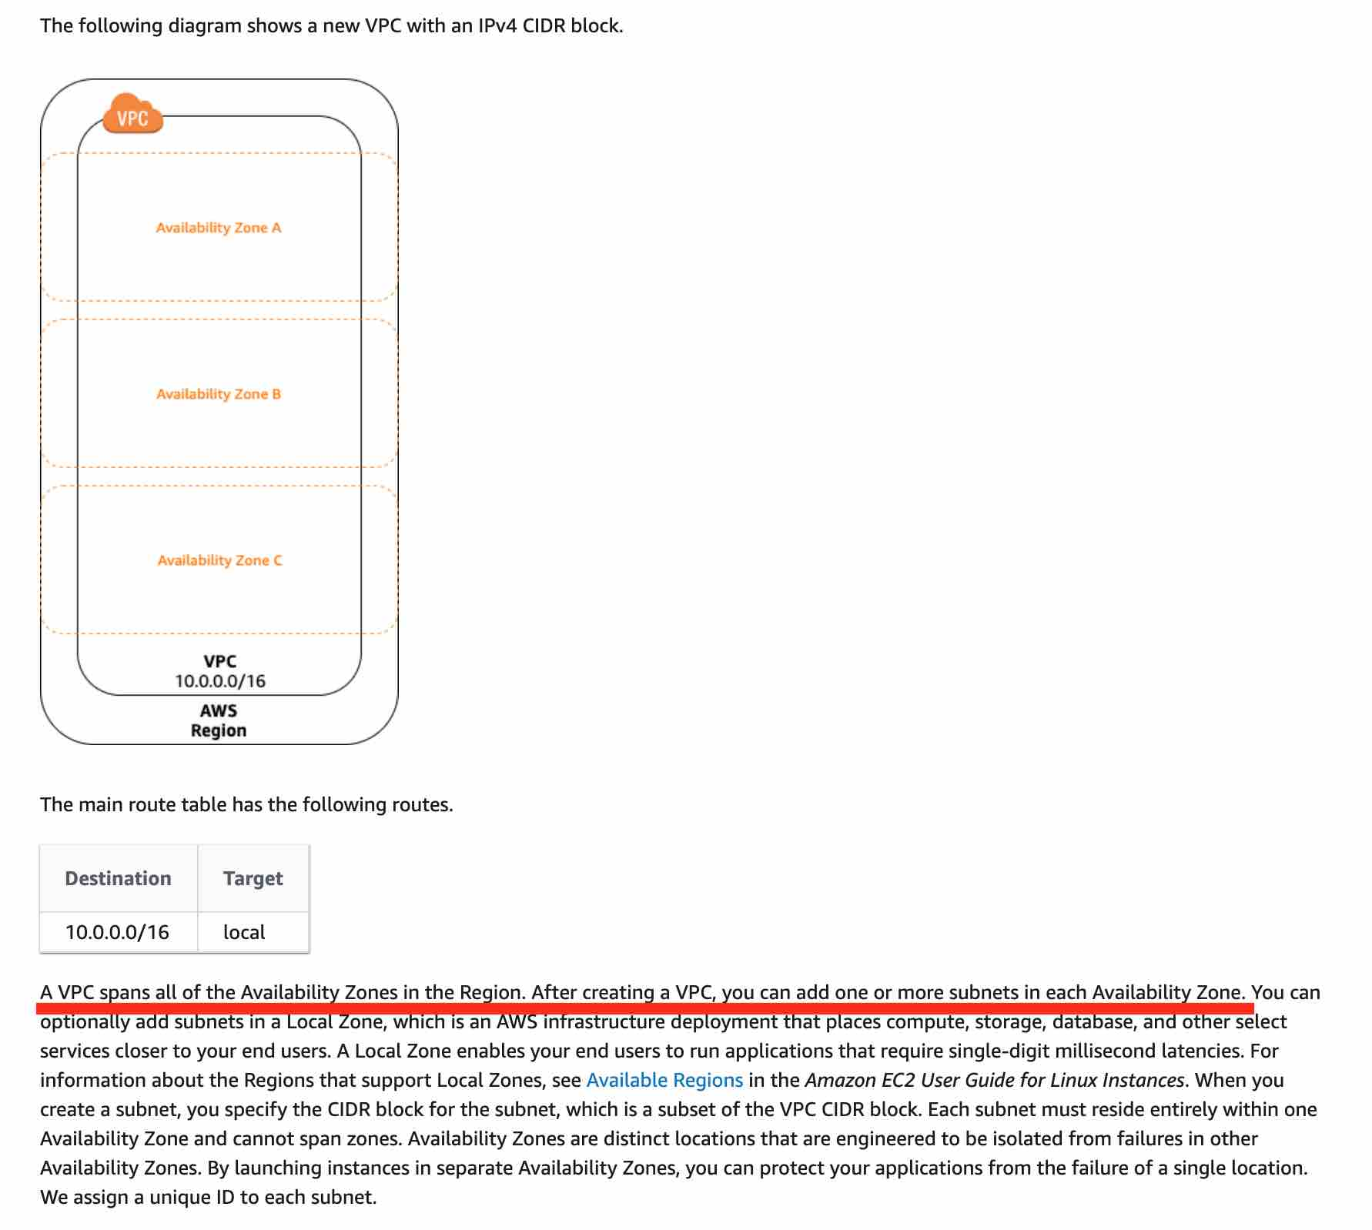
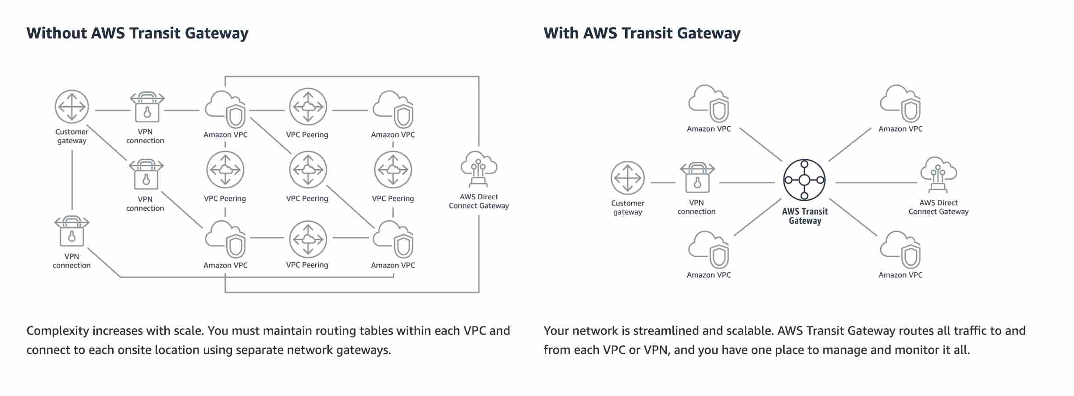
VPC Peering - A VPC peering connection is a networking connection between two VPCs that enables you to route traffic between them privately.

Slide 9
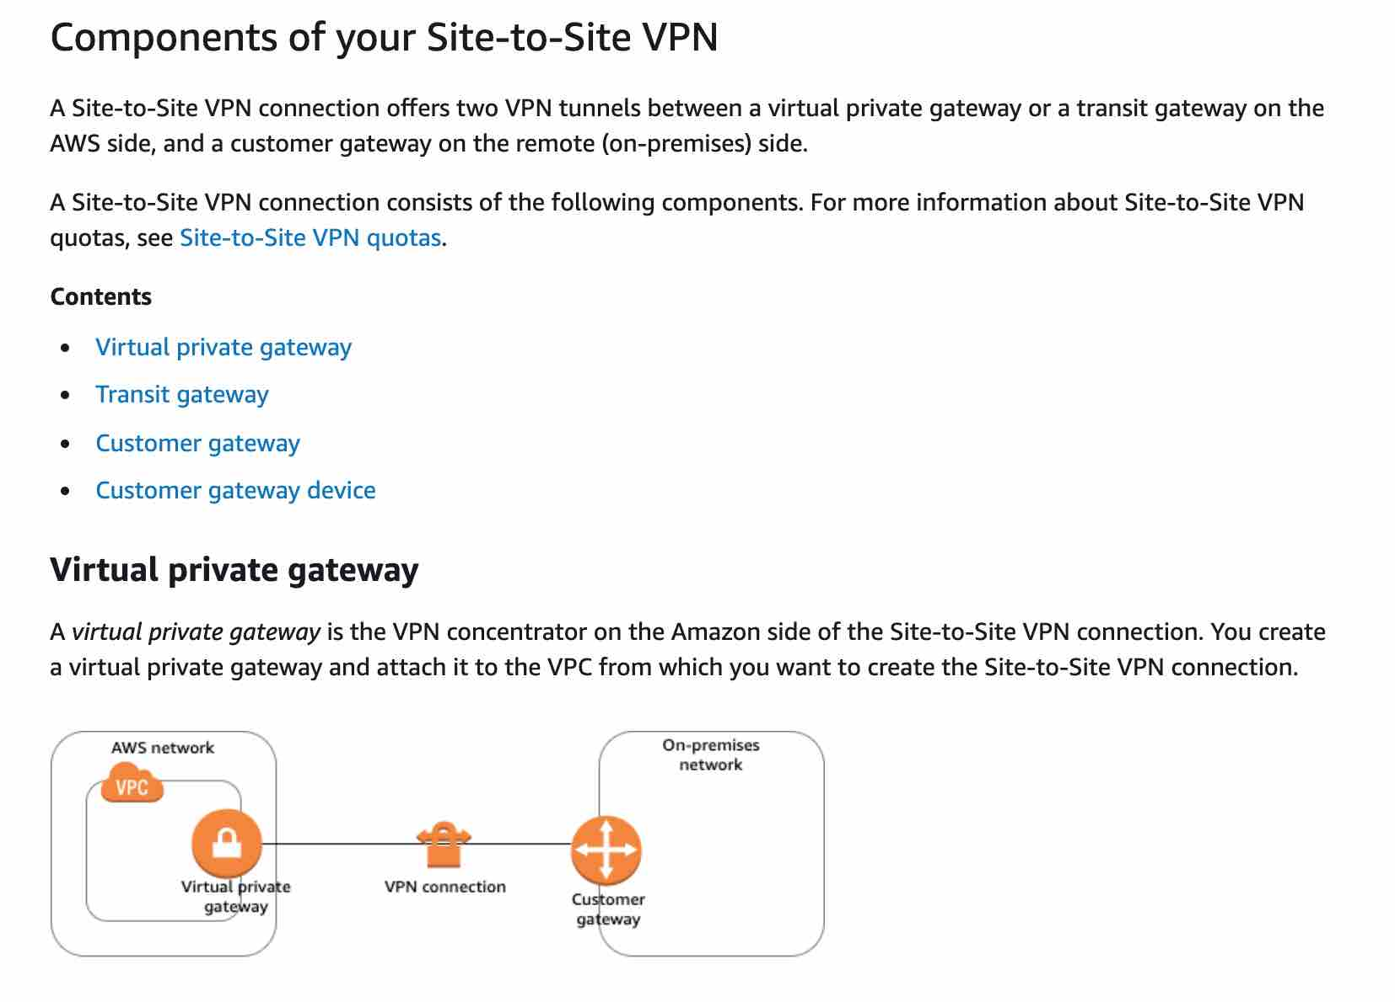
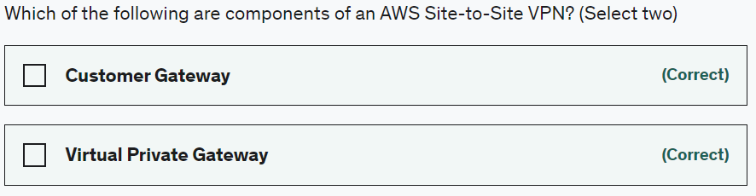

Slide 10
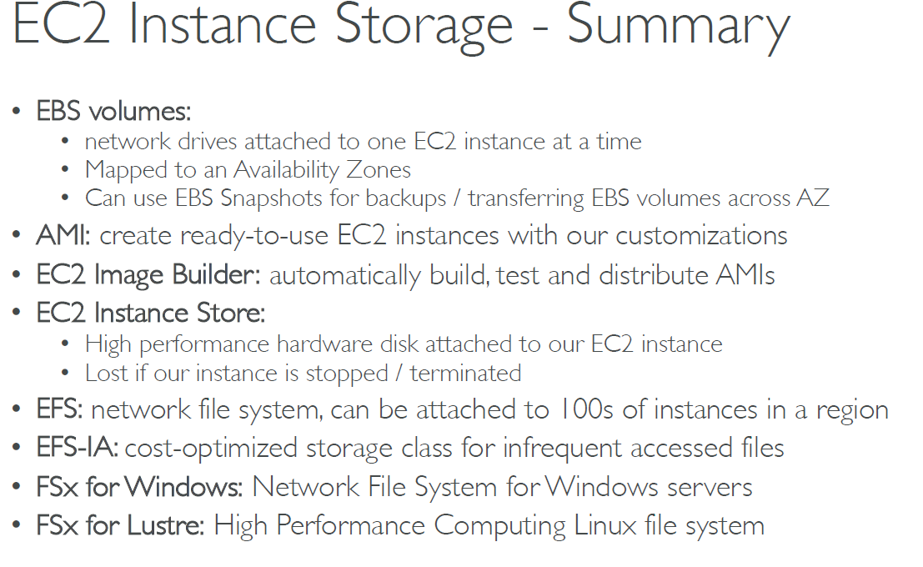

Slide 11
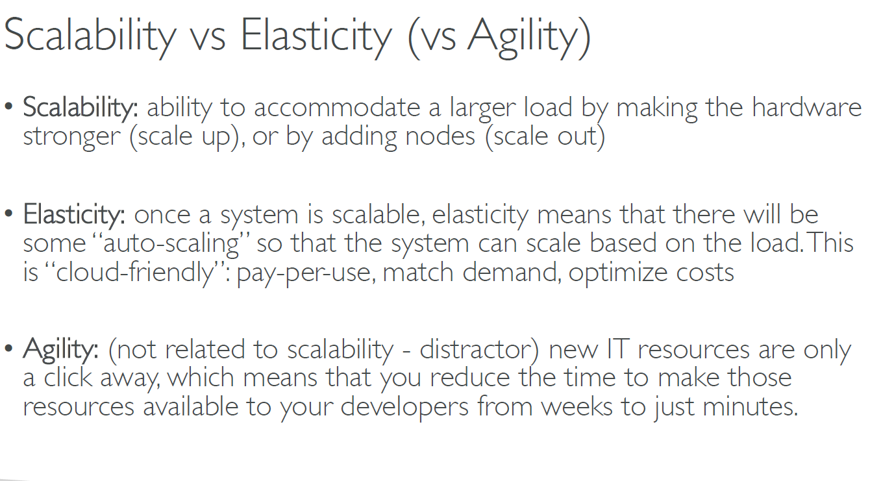

Slide 12
Auto Scaling Strategies include: Manual Scaling, Dynamic Scaling (Simple/Step Scaling, Target Tracking Scaling, Scheduled Scaling), and Predictive Scaling.

Slide 13
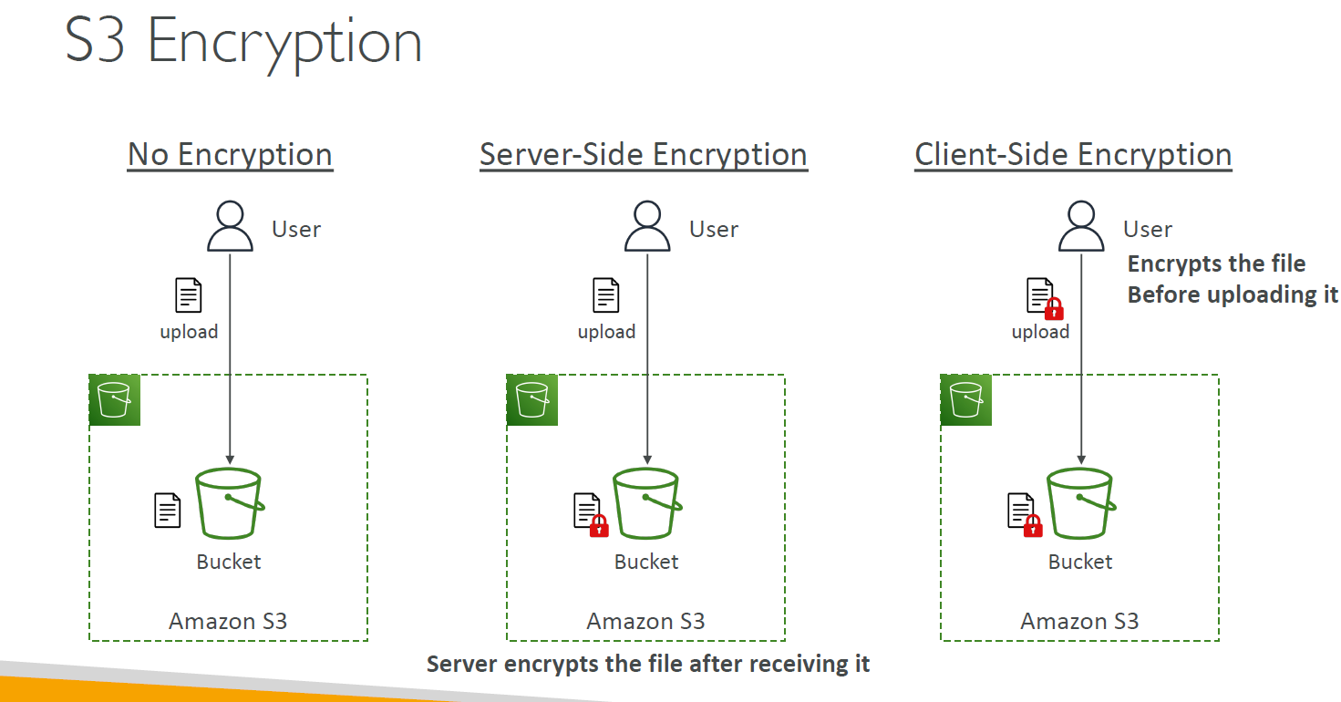
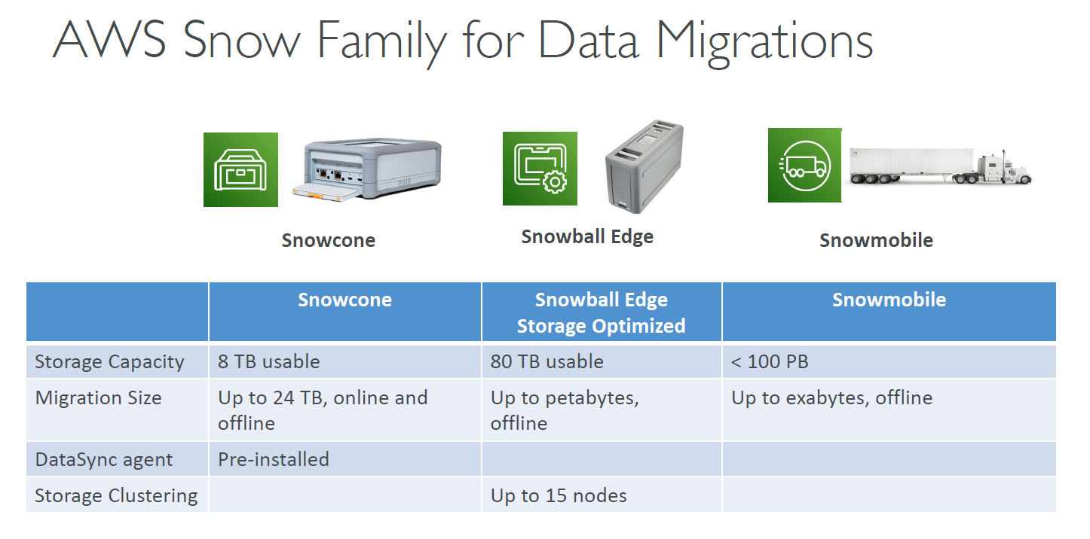

Slide 14
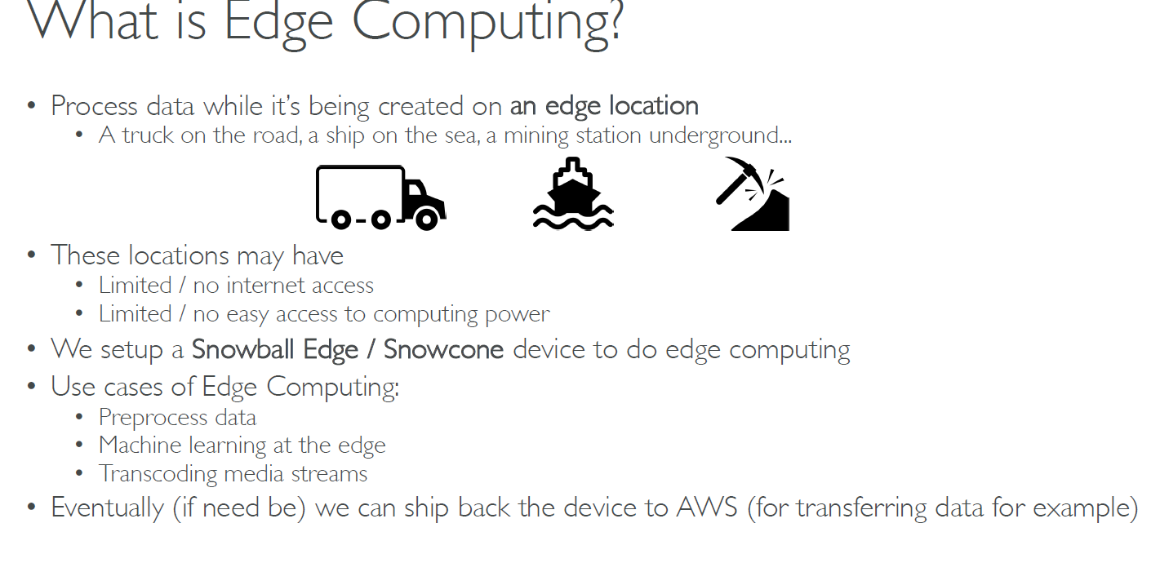

Slide 15
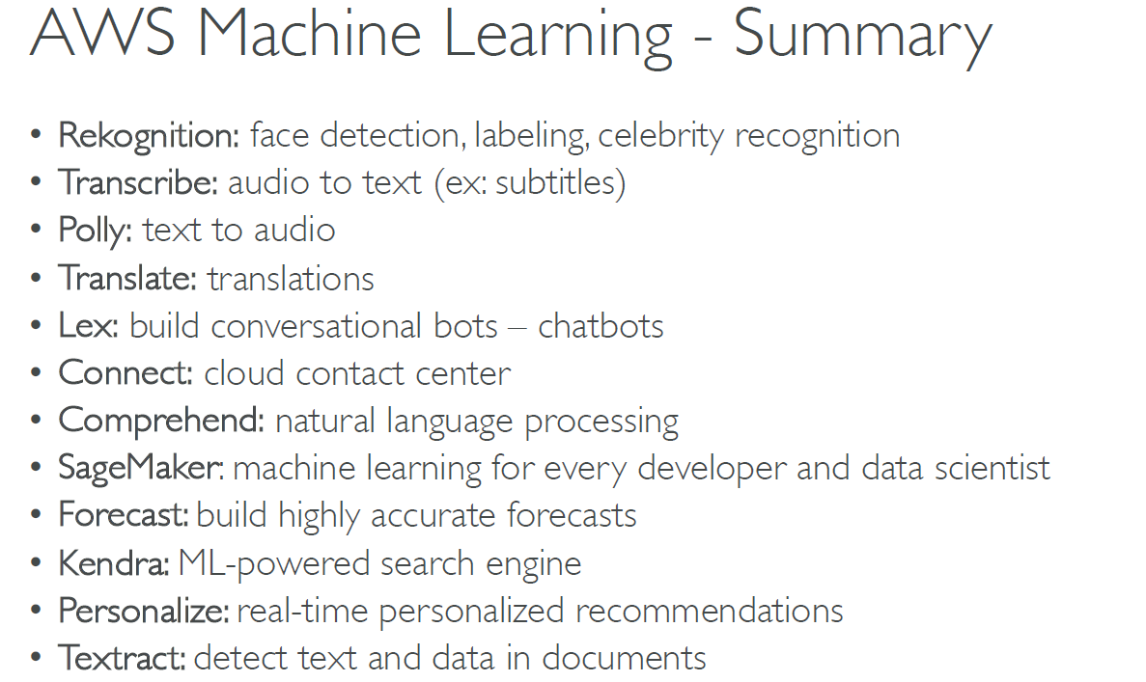

Slide 16
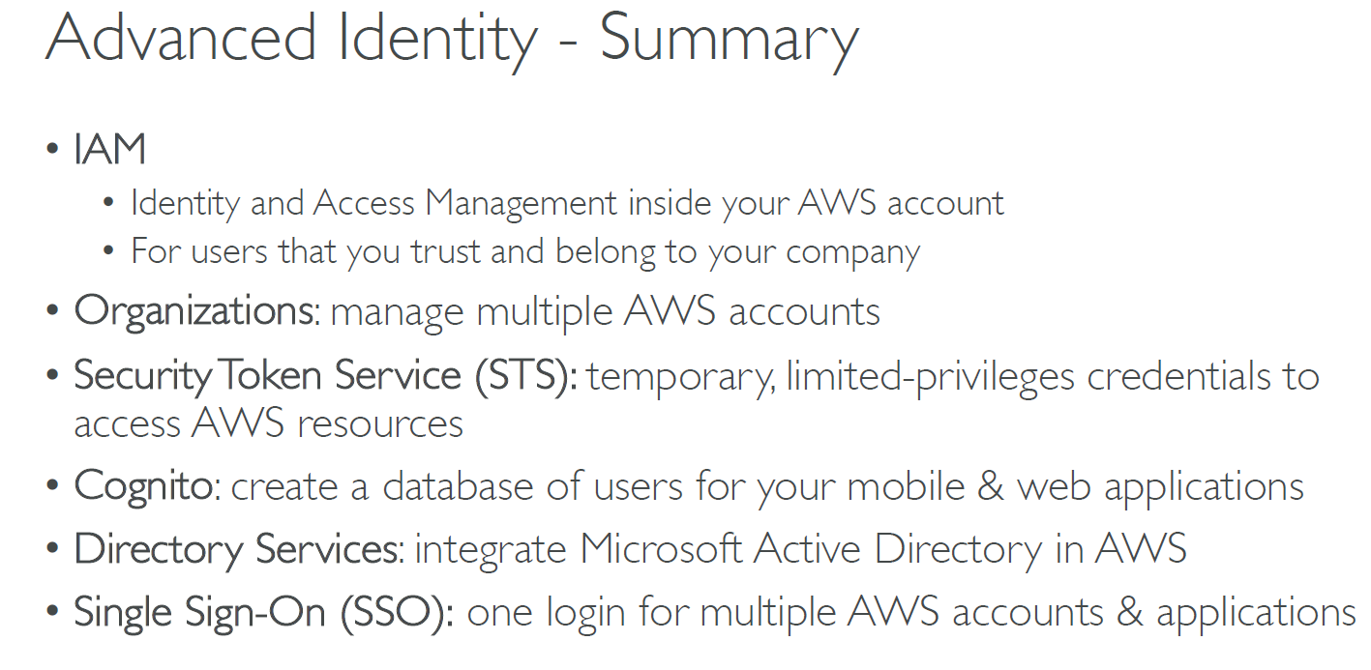

Slide 17
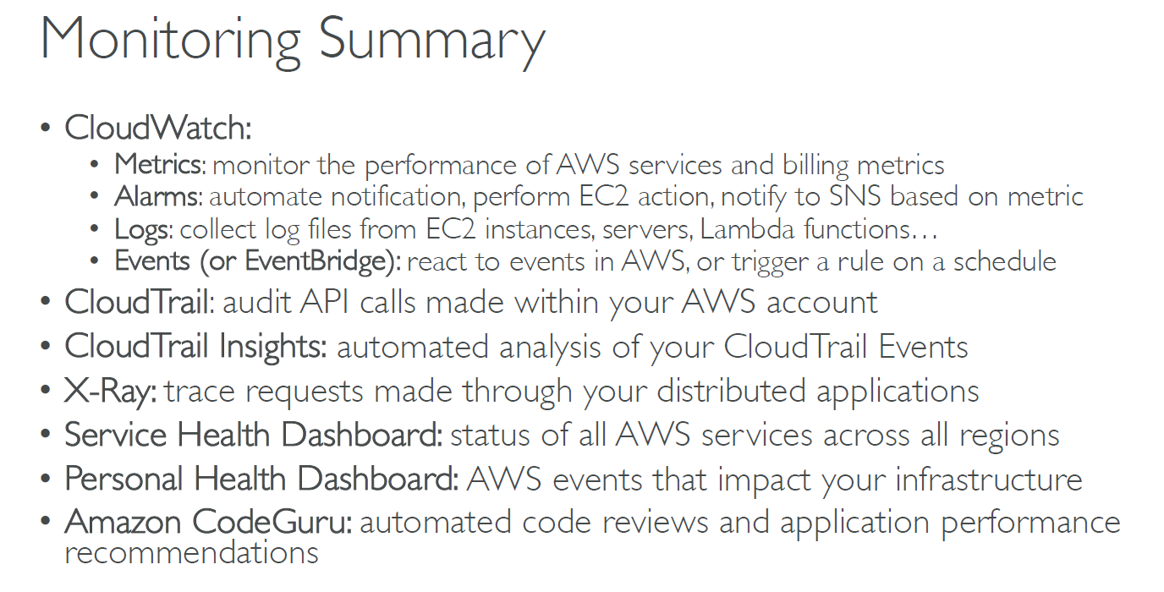

Slide 18
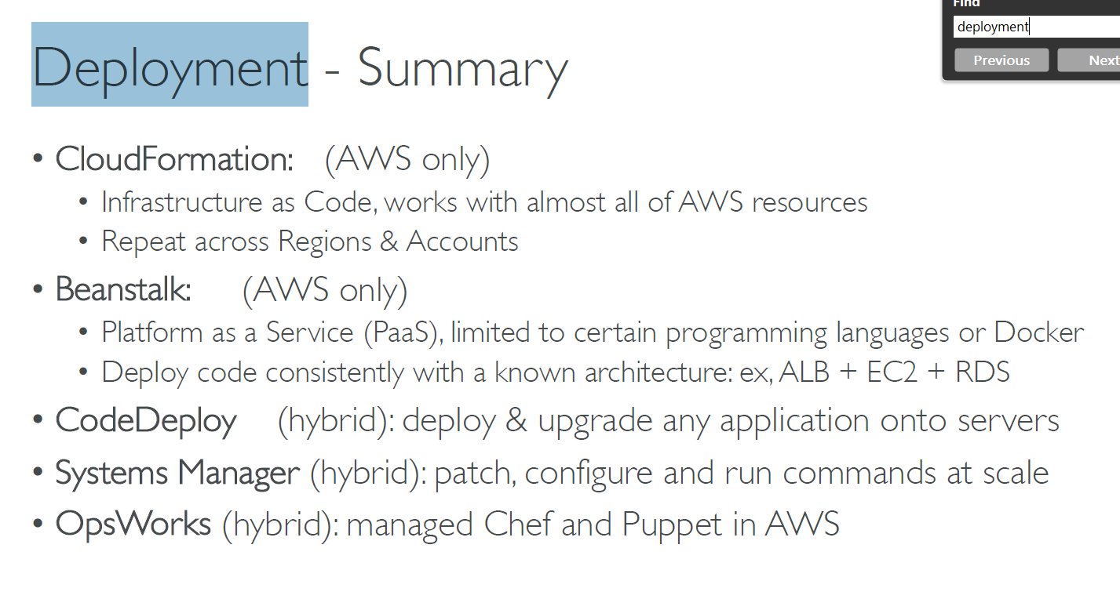

Slide 19
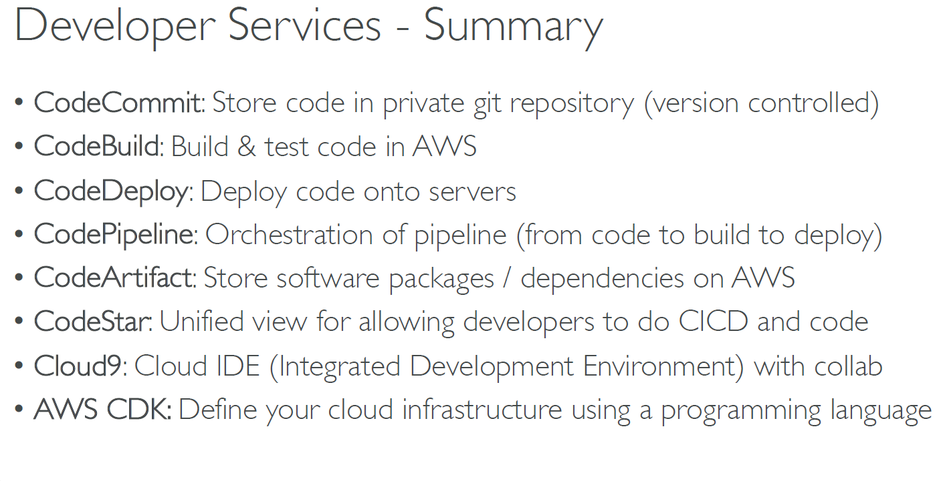

Slide 20
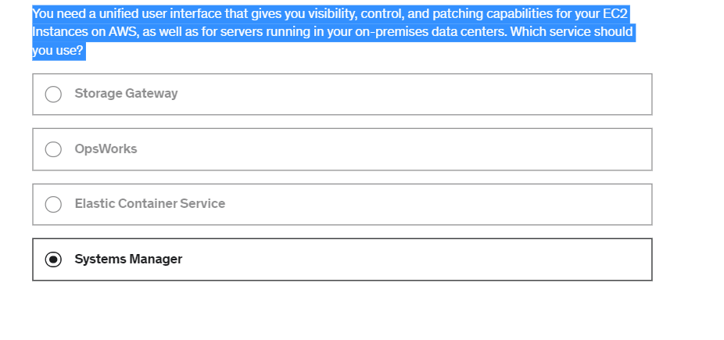

Slide 21
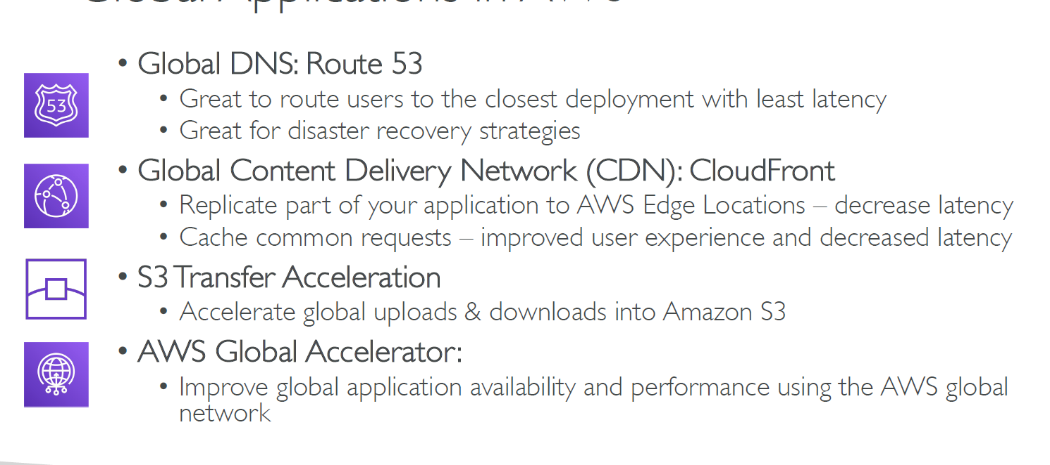

Slide 22
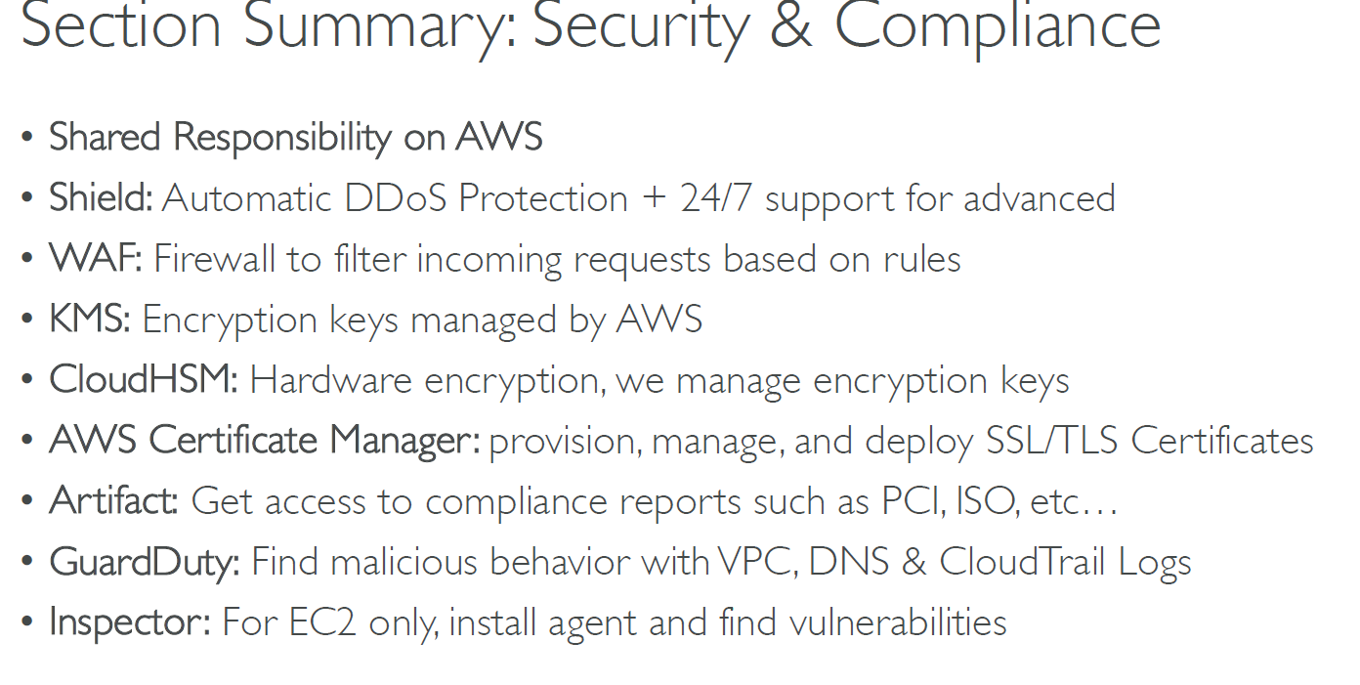

Slide 23
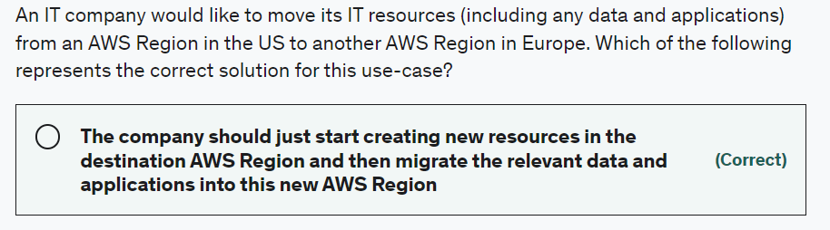
Elastic Beanstalk as its meant for automatic application deployment when you upload your code. Then Elastic Beanstalk automatically handles the deployment, from capacity provisioning, load balancing, auto-scaling to application health monitoring.

Slide 24
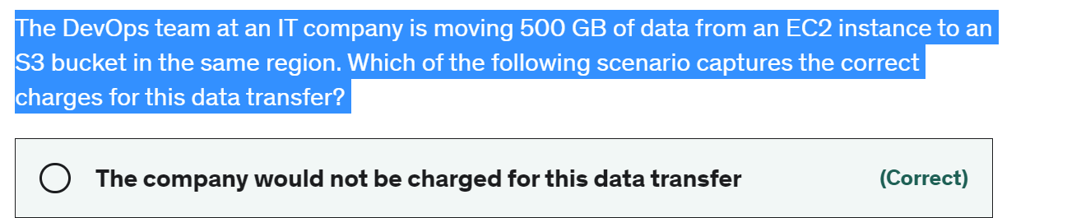
Basic - The basic plan only provides access to the following:
Customer Service & Communities - 24x7 access to customer service, documentation, whitepapers, and support forums. AWS Trusted Advisor - Access to the 7 core Trusted Advisor checks and guidance to provision your resources following best practices to increase performance and improve security. AWS Personal Health Dashboard - A personalized view of the health of AWS services, and alerts when your resources are impacted.
Developer - AWS recommends Developer Support if you are testing or doing early development on AWS and want the ability to get email-based technical support during business hours as well as general architectural guidance as you build and test. This plan provides access to just the 7 core Trusted Advisor checks.

Slide 25
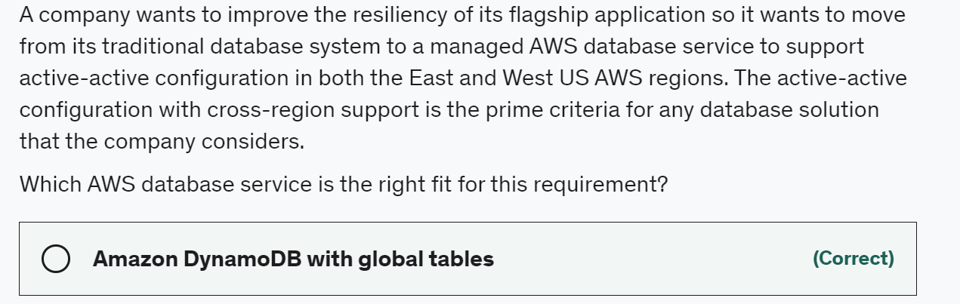

Slide 26
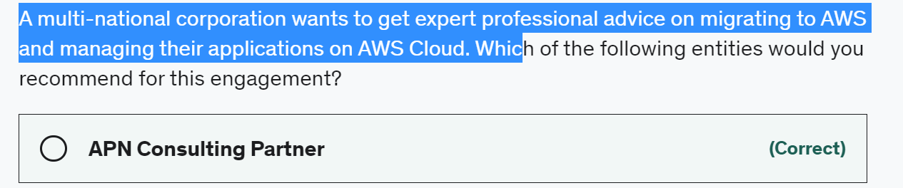
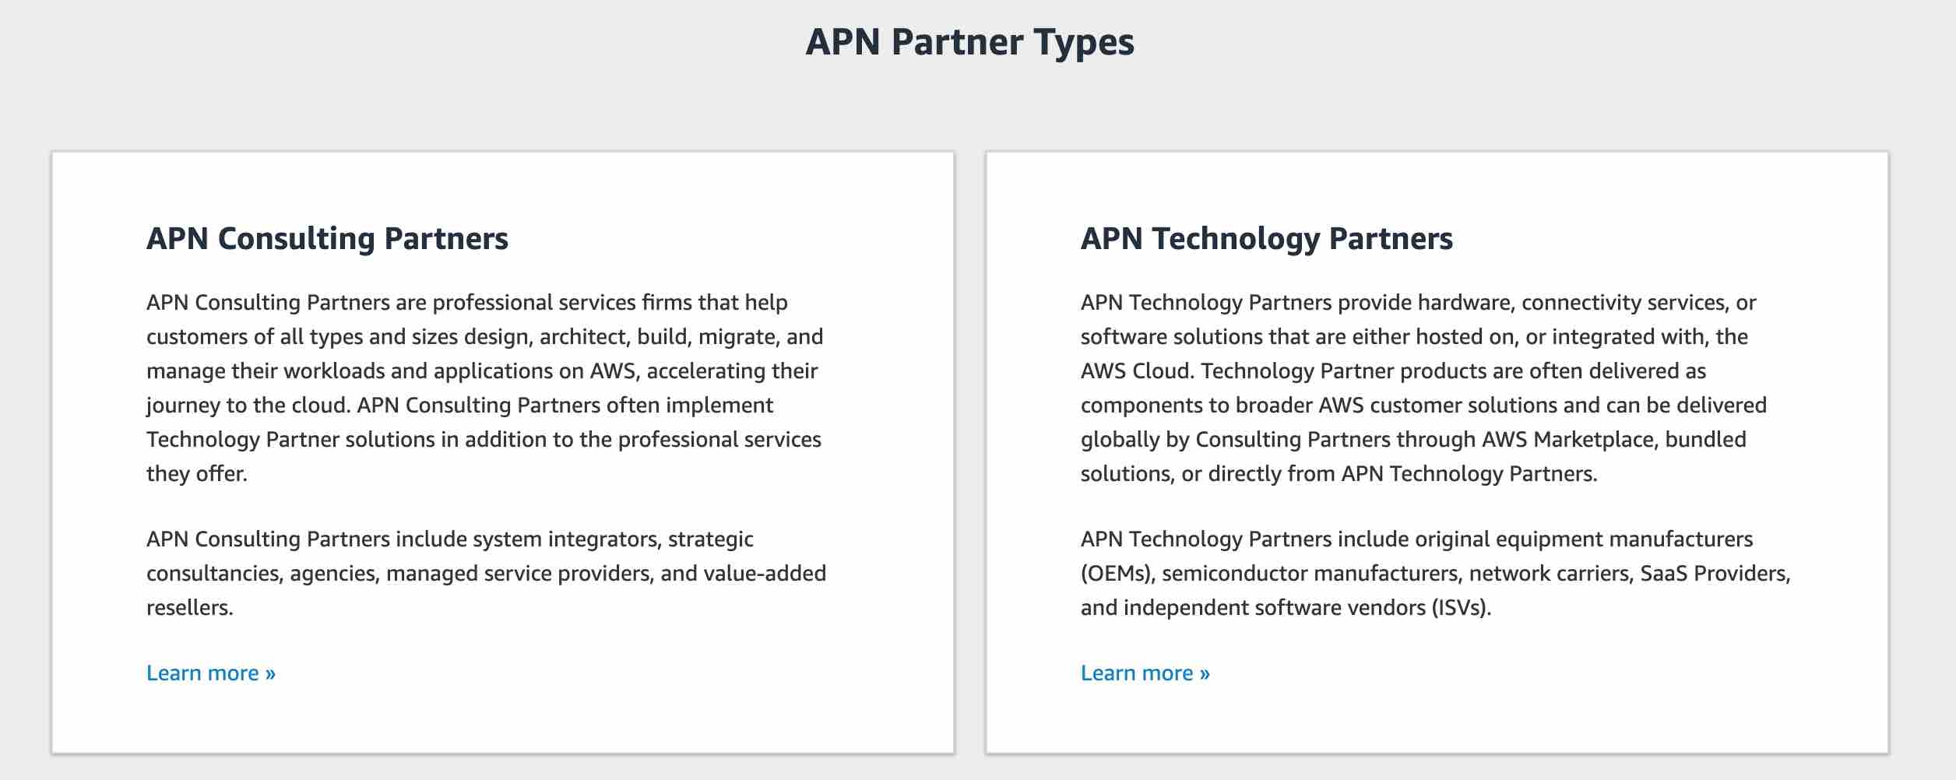

Slide 27
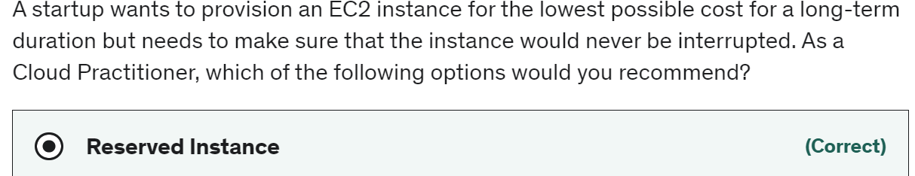
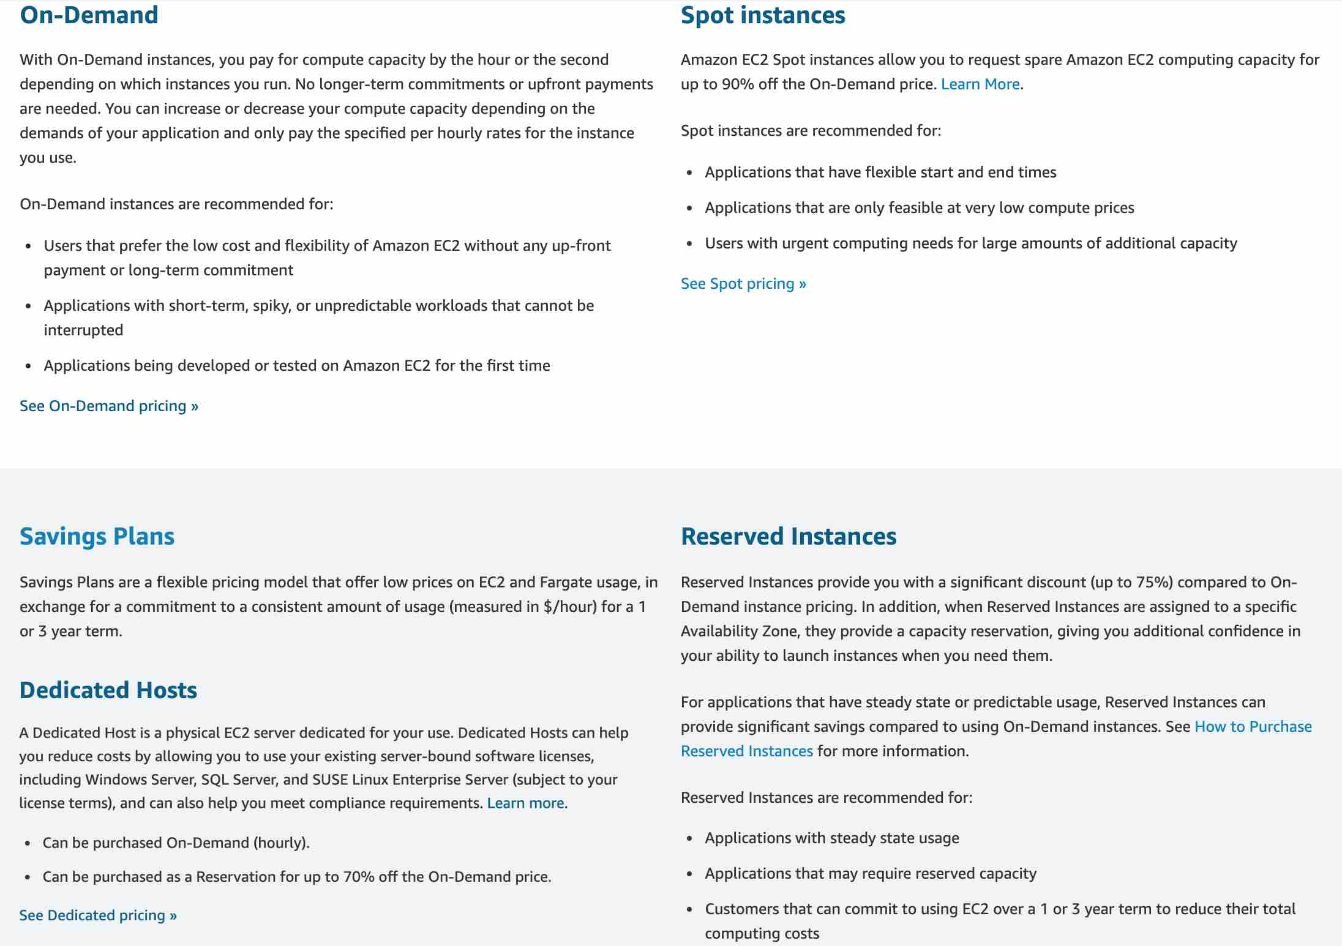
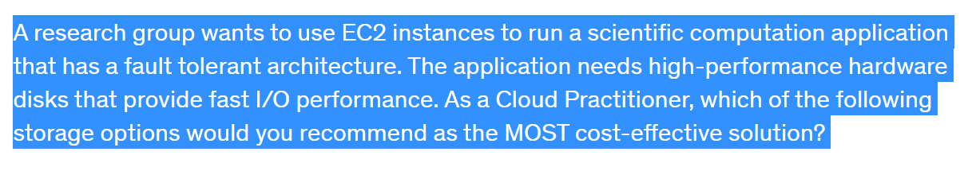

Slide 28
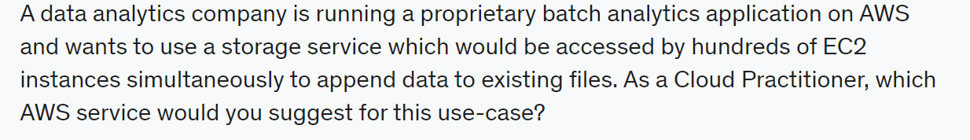
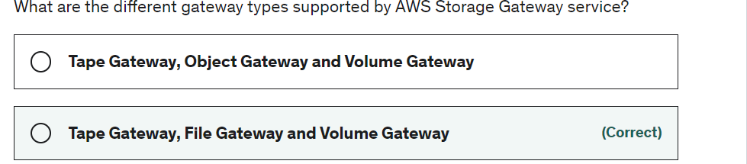
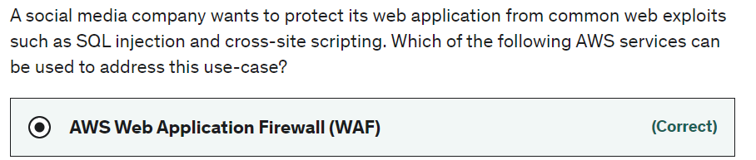
"EFS" - Amazon EFS is a file storage service for use with Amazon EC2. Amazon EFS provides a file system interface, file system access semantics, and concurrently-accessible storage for up to thousands of Amazon EC2 instances. Amazon EFS uses the Network File System protocol.

Slide 29
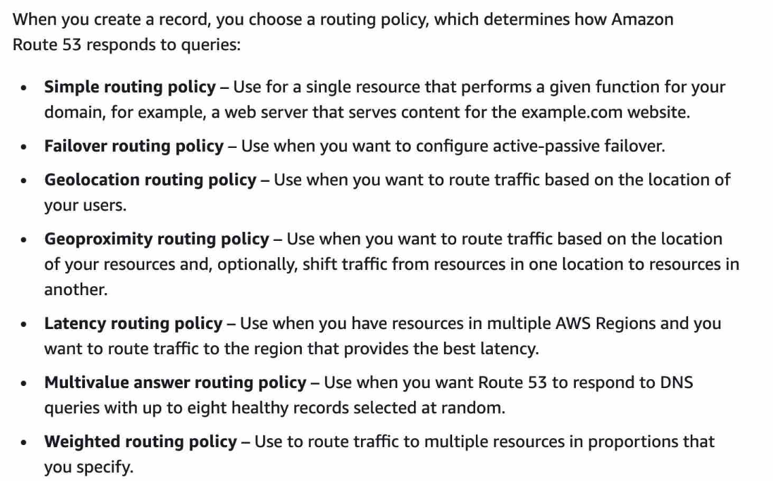
Amazon Route 53 is a highly available and scalable cloud Domain Name System (DNS) web service

Slide 30
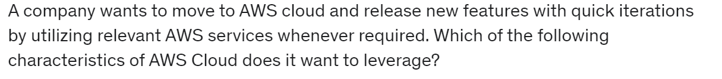
Agility
In the world of cloud computing, "Agility" refers to the ability to rapidly develop, test and launch software applications that drive business growth Another way to explain "Agility" - AWS provides a massive global cloud infrastructure that allows you to quickly innovate, experiment and iterate. Instead of waiting weeks or months for hardware, you can instantly deploy new applications. This ability is called Agility.
Incorrect options:
Elasticity - This refers to the ability to acquire resources as you need and release when they are no longer needed is termed as Elasticity of the Cloud.
Reliability - This refers to the ability of a system to recover from infrastructure or service disruptions, by dynamically acquiring computing resources to meet demand, and mitigate disruptions.
Scalability - Scalability is the measurement of a system's ability to grow to accommodate an increase in demand, or shrink down to a diminishing demand.

Slide 31
Amazon EC2 Reserved Instances: You can use Amazon EC2 Reserved Instances to reserve capacity and receive a discount on your instance usage compared to running On-Demand instances.
Amazon DynamoDB Reserved Capacity: If you can predict your need for Amazon DynamoDB read-and-write throughput, Reserved Capacity offers significant savings over the normal price of DynamoDB provisioned throughput capacity.
Amazon ElastiCache Reserved Nodes: Amazon ElastiCache Reserved Nodes give you the option to make a low, one-time payment for each cache node you want to reserve and, in turn, receive a significant discount on the hourly charge for that node.
Amazon RDS RIs: Like Amazon EC2 RIs, Amazon RDS RIs can be purchased using No Upfront, Partial Upfront, or All Upfront terms. All Reserved Instance types are available for Aurora, MySQL, MariaDB, PostgreSQL, Oracle, and SQL Server database engines.
Amazon Redshift Reserved Nodes: If you intend to keep an Amazon Redshift cluster running continuously for a prolonged period, you should consider purchasing reserved-node offerings. These offerings provide significant savings over on-demand pricing, but they require you to reserve compute nodes and commit to paying for those nodes for either a 1- or 3-year duration.

Slide 32
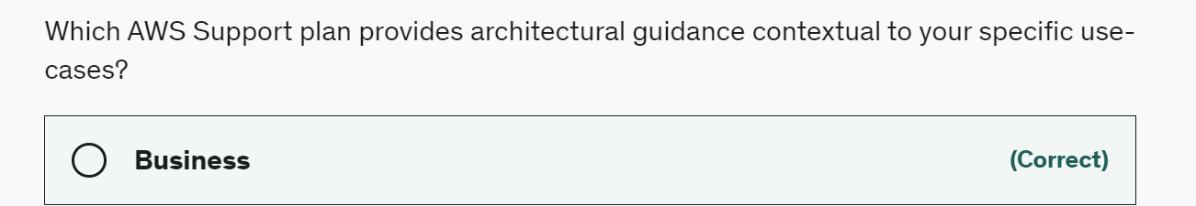
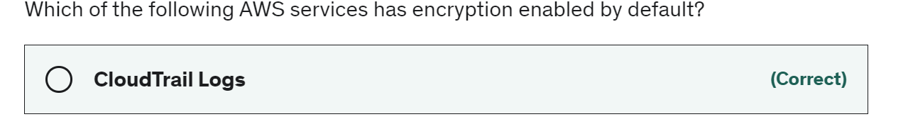
An intern at an IT company provisioned a Linux based On-demand EC2 instance with per-second billing but terminated it within 30 seconds as he wanted to provision another instance type. What is the duration for which the instance would be charged?
60 seconds - There is a one-minute minimum charge for Linux based EC2 instances, so this is the correct option.
https://aws.amazon.com/premiumsupport/plans/

Slide 33
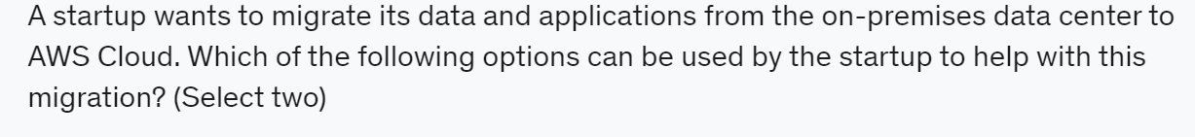
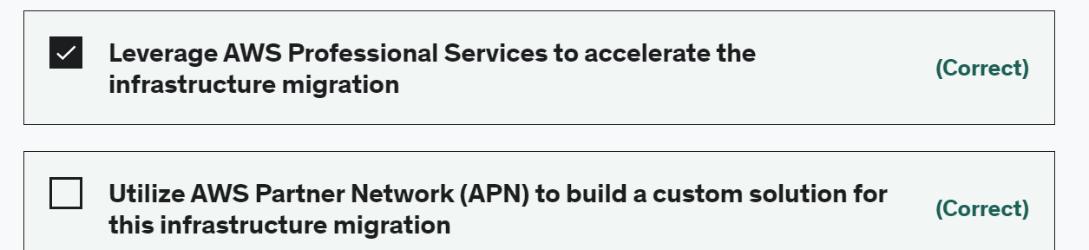

Slide 34
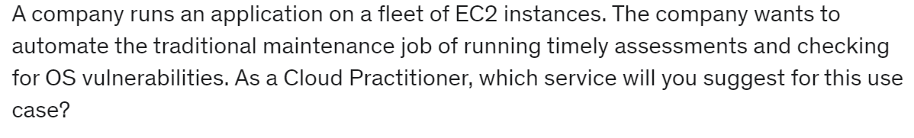
Amazon Inspector
Amazon Inspector is an automated security assessment service that helps improve the security and compliance of applications deployed on your Amazon EC2 instances. Amazon Inspector automatically assesses applications for exposure, vulnerabilities, and deviations from best practices. After performing an assessment, Amazon Inspector produces a detailed list of security findings prioritized by level of severity. These findings can be reviewed directly or as part of detailed assessment reports which are available via the Amazon Inspector console or API.
Incorrect options:
Amazon GuardDuty - Amazon GuardDuty is a threat detection service that monitors malicious activity and unauthorized behavior to protect your AWS account. GuardDuty analyzes billions of events across your AWS accounts from AWS CloudTrail (AWS user and API activity in your accounts), Amazon VPC Flow Logs (network traffic data), and DNS Logs (name query patterns). This service is for AWS account level access, not for instance-level management like an EC2. GuardDuty cannot be used to check OS vulnerabilities.
Amazon Macie - Amazon Macie is a fully managed data security and data privacy service that uses machine learning and pattern matching to discover and protect your sensitive data in AWS. Macie helps identify and alert you to sensitive data, such as personally identifiable information (PII). This service is for securing data and has nothing to do with an EC2 security assessment. Macie cannot be used to check OS vulnerabilities.
AWS Shield - AWS Shield is a managed Distributed Denial of Service (DDoS) protection service that safeguards applications running on AWS. AWS Shield provides always-on detection and automatic inline mitigations that minimize application downtime and latency, so there is no need to engage AWS Support to benefit from DDoS protection. Shield is general protection against DDos attacks for all resources in the AWS network, and not an instance-level security assessment service. Shield cannot be used to check OS vulnerabilities.

Slide 35
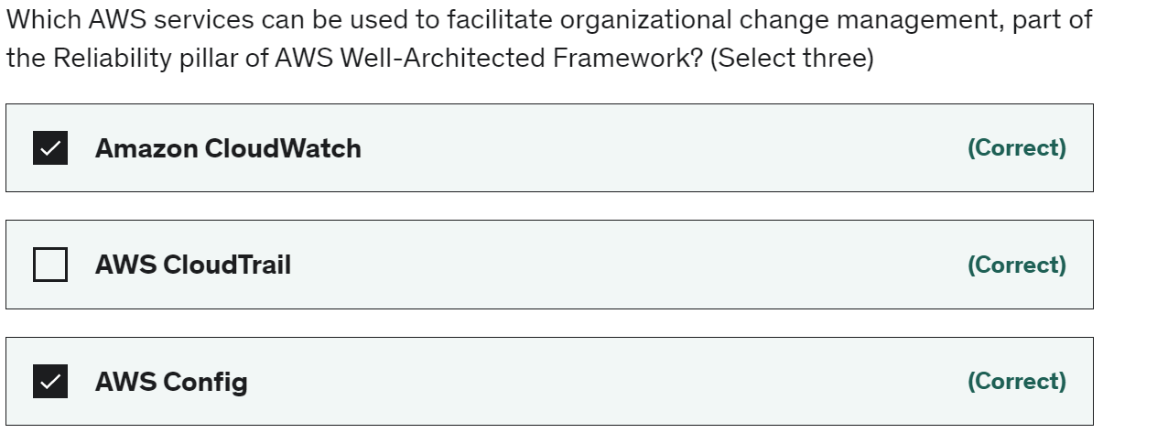
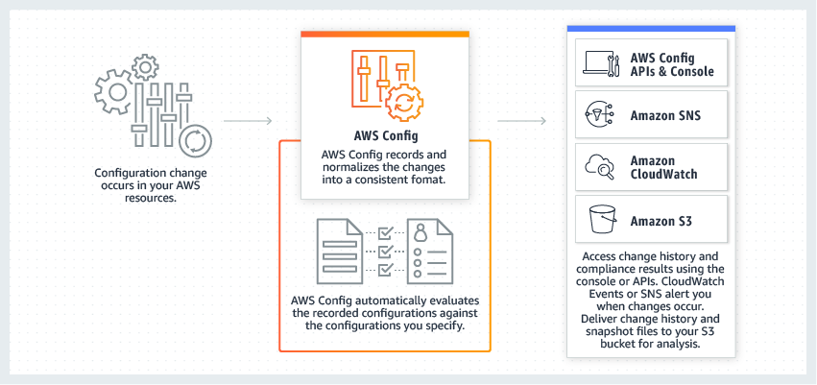
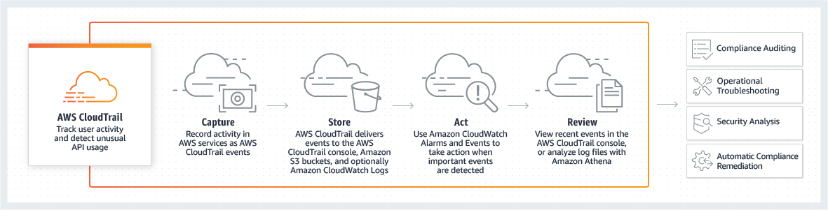
Reliability in the cloud - Foundations, Change Management, Failure Management. Being aware of how change affects a system (change management) allows you to plan proactively, and monitoring allows you to quickly identify trends that could lead to capacity issues or SLA breaches.
Amazon CloudWatch - Amazon CloudWatch is a monitoring and observability service built for DevOps engineers, developers, site reliability engineers (SREs), and IT managers. CloudWatch provides data and actionable insights to monitor applications, respond to system-wide performance changes, optimize resource utilization, and get a unified view of operational health.

Slide 36
You can remove an account from your organization only if the account has the information that is required for it to operate as a standalone account. For each account that you want to make standalone, you must accept the AWS Customer Agreement, choose a support plan, provide and verify the required contact information, and provide a current payment method. AWS uses the payment method to charge for any billable (not AWS Free Tier) AWS activity that occurs while the account isn't attached to an organization.
AWS Shield Standard defends against most common, frequently occurring network and transport layer DDoS attacks that target your website or applications. While AWS Shield Standard helps protect all AWS customers, you get better protection if you are using Amazon CloudFront and Amazon Route 53. All AWS customers benefit from the automatic protections of AWS Shield Standard, at no additional charge.

Slide 37
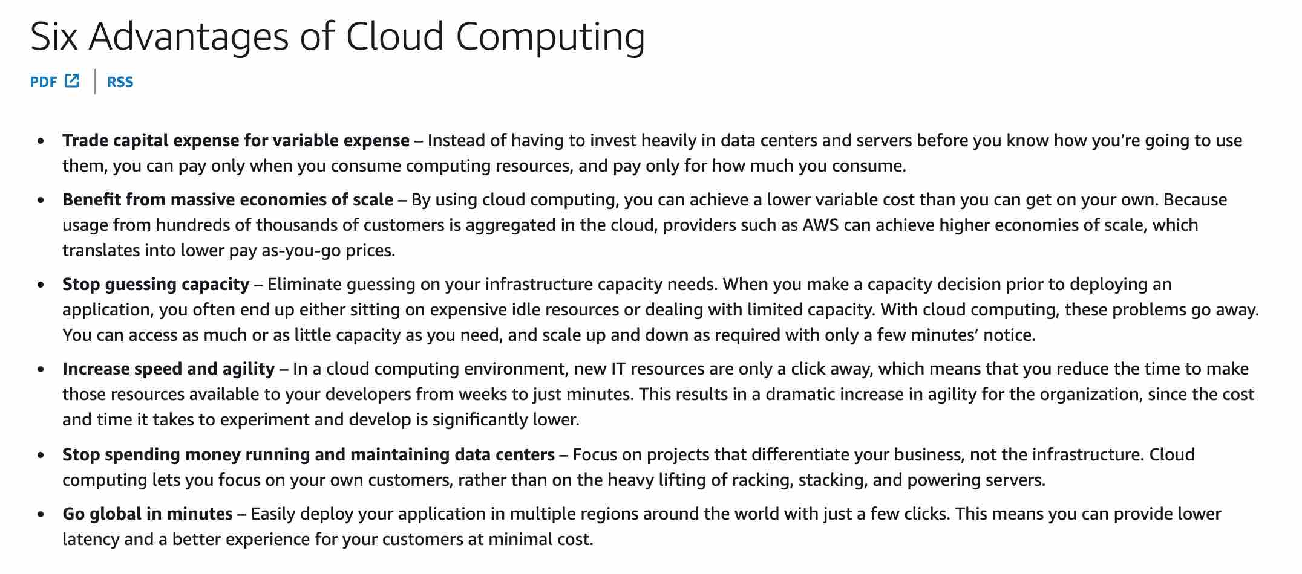
AWS Shield Advanced provides expanded DDoS attack protection for web applications running on the following resources: Amazon Elastic Compute Cloud, Elastic Load Balancing (ELB), Amazon CloudFront, Amazon Route 53, AWS Global Accelerator.

Slide 38
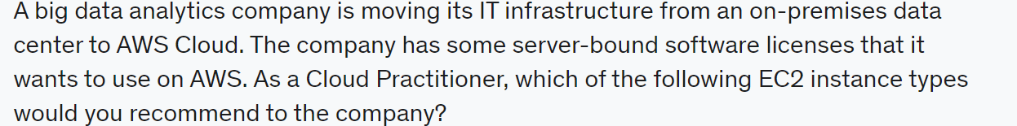
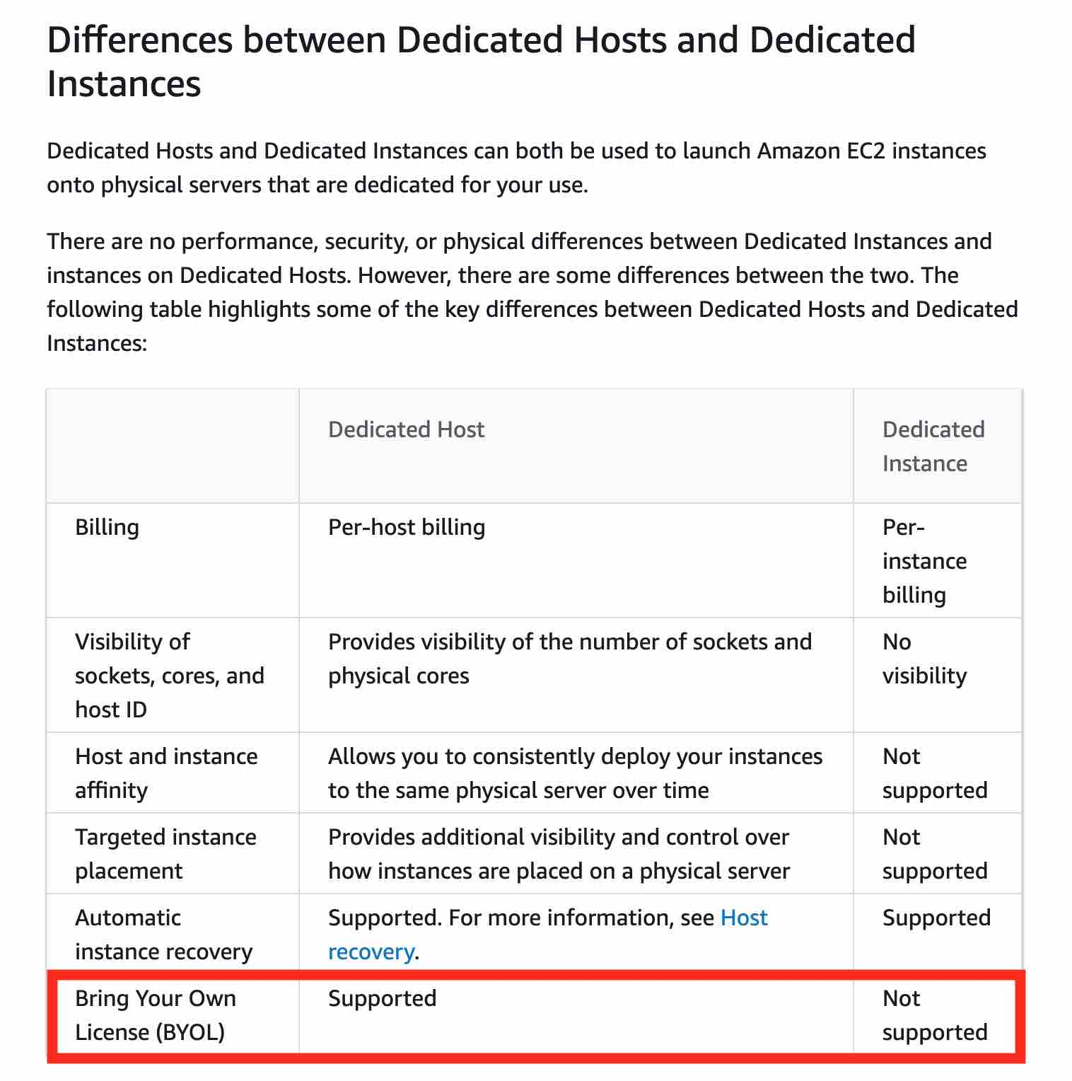
All you need to remember is that a 3 years term would always be more cost-effective than a 1-year term. Then within a term, "all upfront" is better than "partial upfront" which in turn is better than "no upfront" from a cost savings perspective.

Slide 39
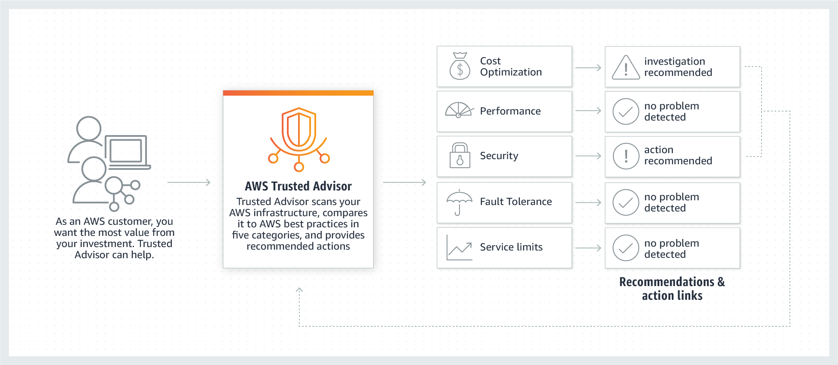

Slide 40



Slide 41

AWS WAF, Route 53
AWS Budgets - Cost budget, Usage budget, Reservation budget and Savings Plans budget.

Slide 43
AWS Well-Architected Framework
Foundations are part of the Reliability pillar of the AWS Well-Architected Framework.
AWS states that before architecting any system, foundational requirements that influence reliability should be in place. The services that are part of foundations are: Amazon VPC, AWS Trusted Advisor, AWS Service Quotas (formerly called AWS Service Limits).
1) Operational Excellence
2) Security
3) Reliability
4) Performance Efficiency
5) Cost Optimization
6) Sustainability

Slide 97


Slide 98


Slide 100


Slide 101


Slide 102


Slide 103


Slide 104


Slide 105


Slide 106


Slide 107


Slide 108


Slide 109


Slide 110


Slide 111


Slide 112


Slide 113


Slide 114


Slide 115


Slide 116


Slide 117


Slide 118


Slide 119


Slide 120


Slide 121


Slide 122


Slide 123


Slide 124



Slide 125


Slide 126


Slide 127


Slide 128


Slide 129


Slide 130


Slide 131


Slide 132


Slide 133


Slide 134


Slide 135


Slide 136


Slide 137



Slide 139


Slide 140


Slide 141


Slide 142


Slide 143


Slide 144


Slide 145


Slide 146


Slide 147


Slide 148


Slide 149


Slide 150


Slide 151


Slide 152


Slide 153


Slide 154


Slide 155


Slide 156


Slide 157


AWS Snowball is a service that provides secure, rugged devices, so you can bring AWS computing and storage capabilities to your edge environments, and transfer data into and out of AWS. Those rugged devices are commonly referred to as AWS Snowball or AWS Snowball Edge devices.

Slide 158



Slide 159



Slide 160


Slide 161


Slide 162


Slide 163


Slide 164


Slide 165



Slide 166



Slide 167


Slide 168



Slide 169



Slide 170


Slide 171



Slide 172


Slide 173


Slide 174



Slide 175



Slide 176

https://youtu.be/4cIaF3uKsKg?t=4160

